Slide 1
Hands-on Machine Learning with Spark
Yushu Yao
UC Berkeley

Slide 2
Plans for today
Model Evaluation
Cross-validation
Collaborative Filtering
Hands-on

Slide 3
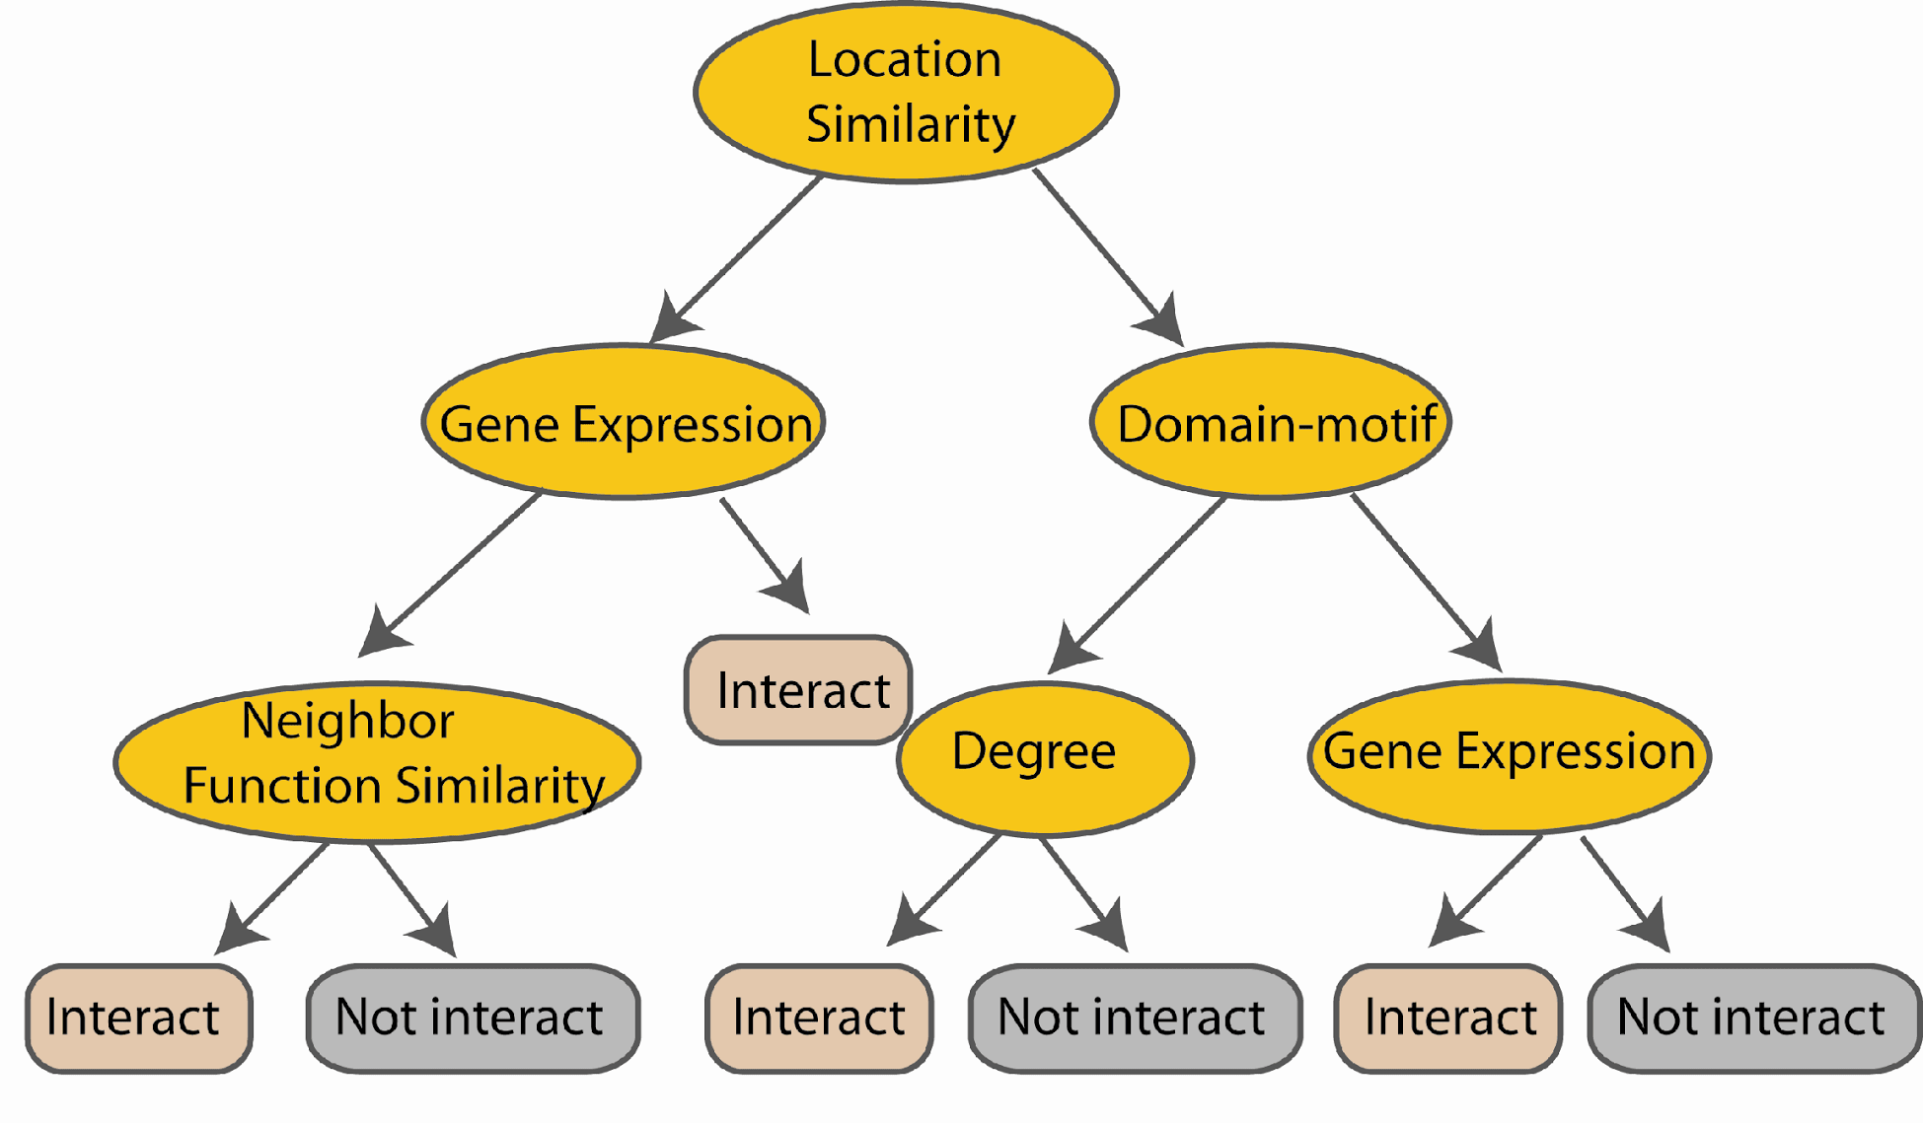
Clarification! Construct Trees
Use random subset of features
At each node in choosing the split feature
choose only among m<M features
M features
N examples
....…

Slide 4
How Well is My Model Doing?

Slide 5
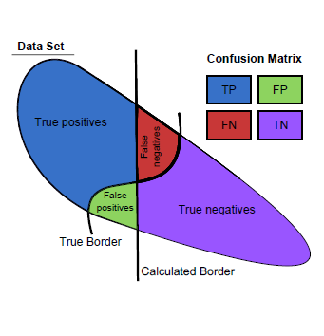
Accuracy
Accuracy = True Predictions/All Predictions
Notes:
Accuracy -> Recall -> Precision -> PR Relation

Slide 6
 | Correct | Not Correct
Selected | tp=0 | fp=0
Not Selected | fn=10 | tn=99990
 | Correct | Not Correct
Selected | tp=8 | fp=30
Not Selected | fn=2 | tn=99960

Slide 7
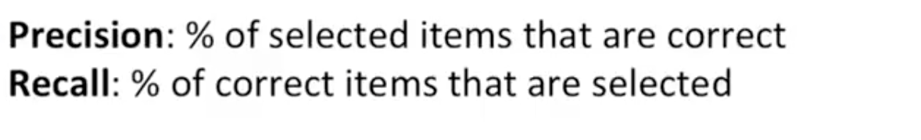
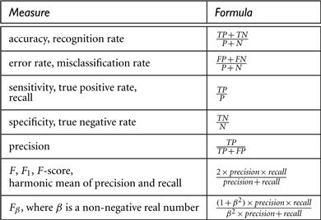

Slide 8
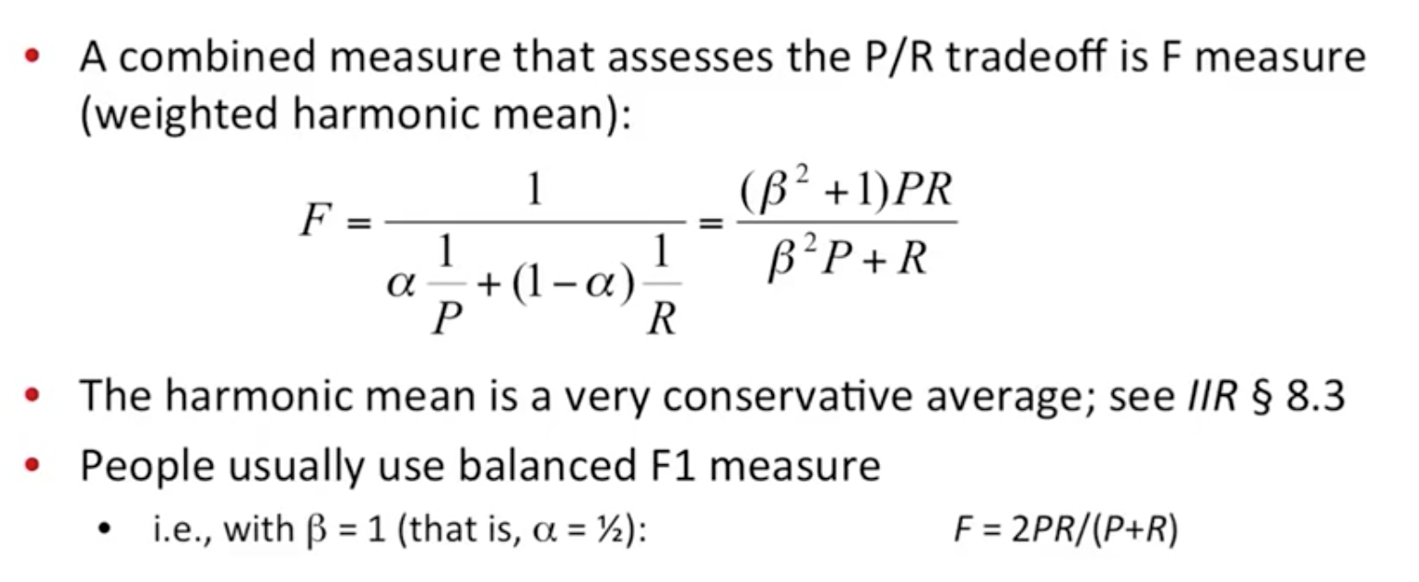
F Score

Slide 10
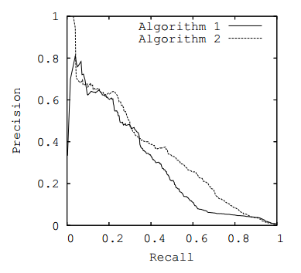
P-C curve

Slide 11
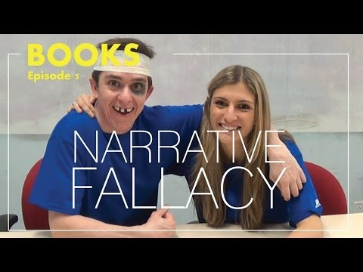
YouTube Time - Narrative Fallacy

Slide 12
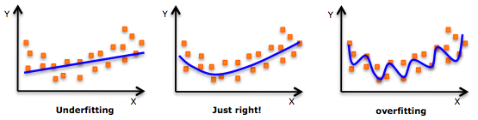
Underfitting and Overfitting

Slide 13
Cross-validation
k-fold cross-validation
Dataset
Train
Test

Slide 14
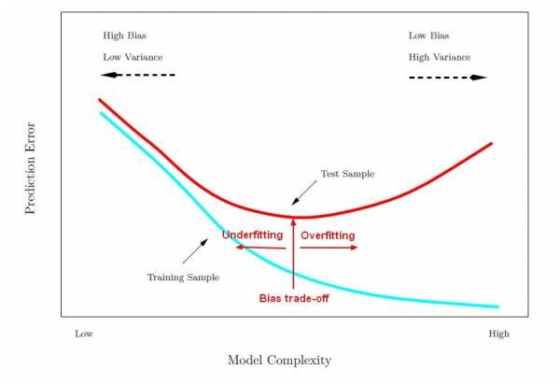
High Bias v.s. High Variance

Slide 15
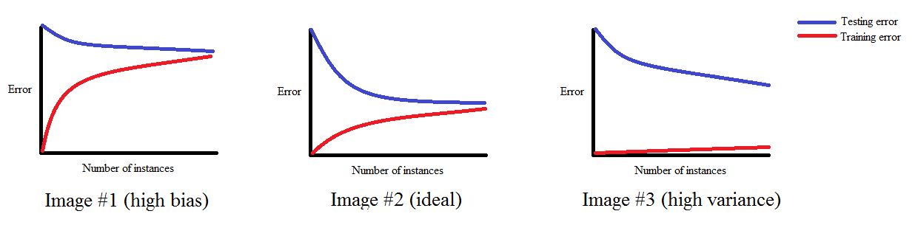
Learning Curve

Slide 16
Collaborative Filtering

Slide 17
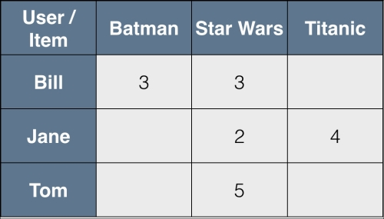
Problem Setup
?

Slide 18
Types of CF
User Based
Item Based
Matrix Factorization (Latent Feature)

Slide 19
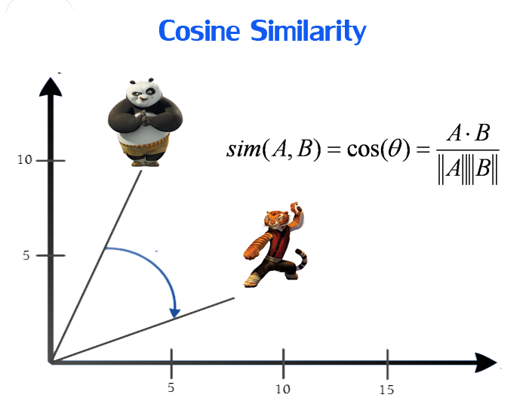
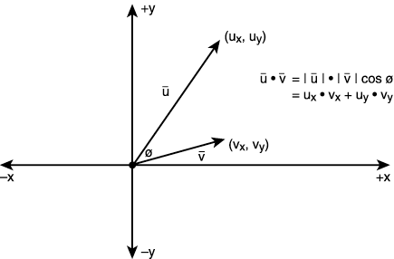
Cosine similarity

Slide 20
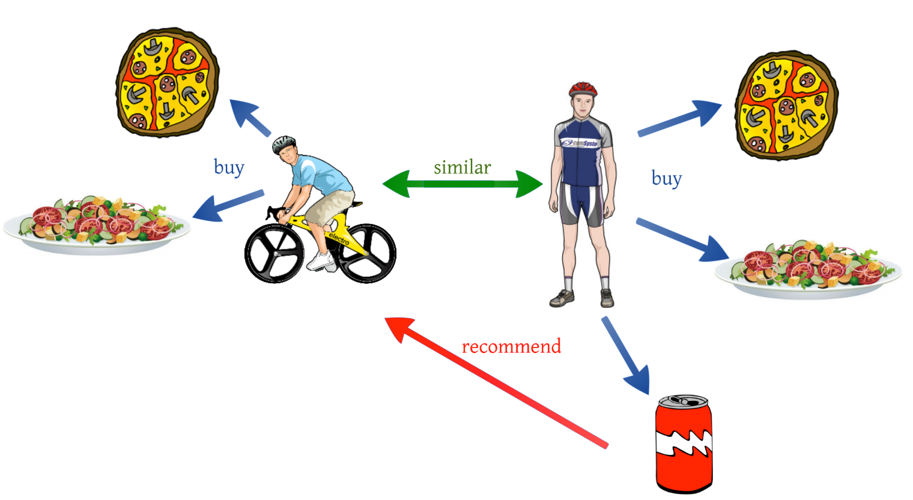
User Based CF
Given a user, look at his/her similar users, and see what they are doing.

Slide 21
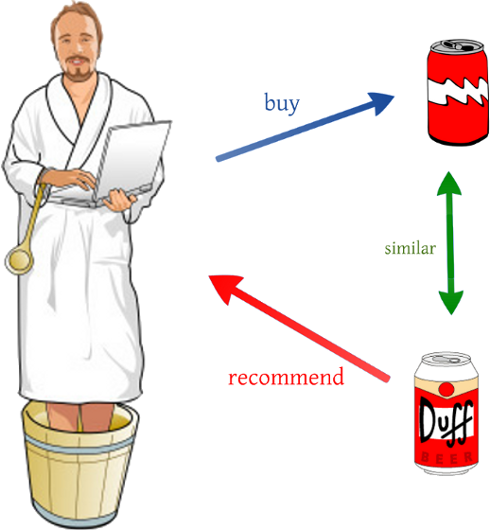
Item based

Slide 22
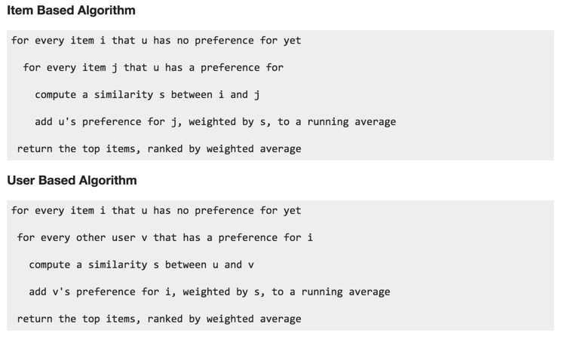
User Based CF

Slide 23
Item based

Slide 24
Matrix Factorization

Slide 25
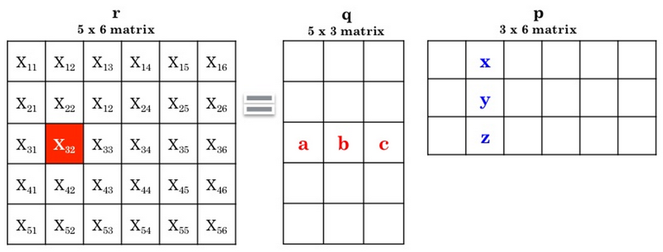
Matrix Multiplication!
X
=

Slide 26
Recall our Problem
?

Slide 27
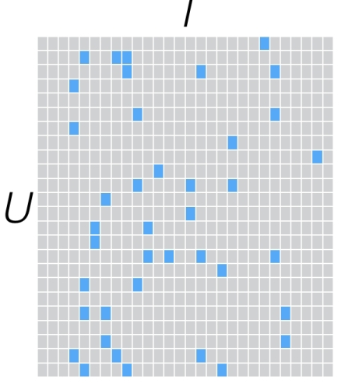
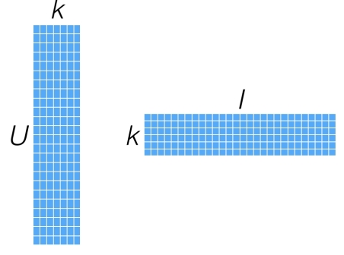
Matrix Factorization
R
P^{T}
Q

Slide 28
Matrix Factorization
R
P^{T}
Q
=
X

Slide 29
What is k? What does each of the k dimensions mean?

Slide 30
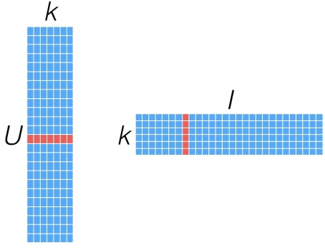
Get User's Rating of an Item

Slide 31
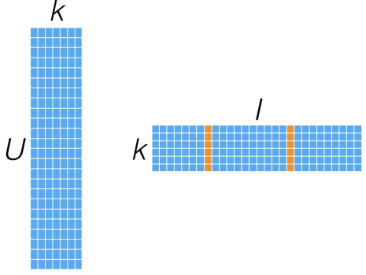
Get Similarity of two items?

Slide 32

How to factorize the matrix?
Error Minimization
Least Square Problem
How to minimize the square error?

Slide 33
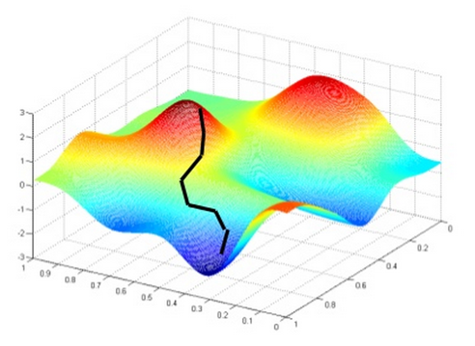
Gradient Descent

Slide 34
Problem with GD?
In each iteration, need to calculate error, i.e. loop through all available data points
What if I have 10B data points?
SGD - Use part of the points to calculate error

Slide 35
Alternating Least Square
Error to Minimize (With Regulation)

Slide 36
How do I know if my model is working?
Mean Square Error (MSE)
Root MSE (RMSE)

Slide 37
Get User's Rating of an Item

Slide 38
Summary
User Based
Item Based
Matrix Factorization/ALS

Slide 39
Hands-on MovieLens Dataset 100K

